Slide 1
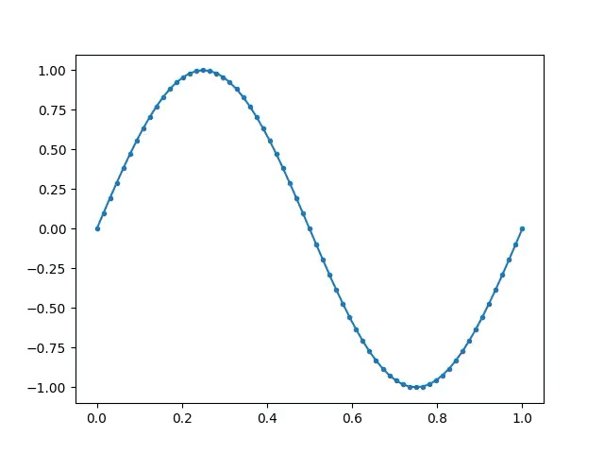
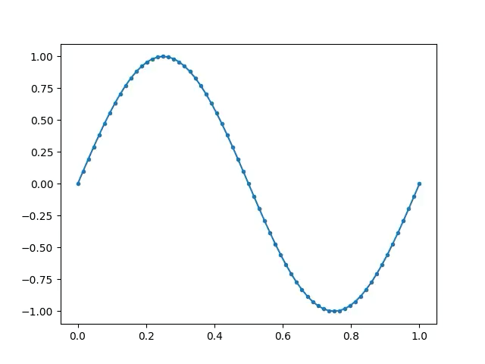
Solution of the Fermi–Pasta–Ulam–Tsingou problem. Linear and non-linear quadratic cases.
Linear model: α=0
Non-linear model: α=0.25

